Slide 1

Analyzing Company Growth Factors
By Avinash & Praveen

Slide 2

Introduction
Our chosen subject is Reliance Industries, one of the largest companies in India by revenue and market capitalization.
In this project, we aim to analyze the key factors driving the company's growth and revenue, with a particular focus on the impact of two major drivers: crude oil prices and the performance of Reliance Jio, the company's telecommunications arm.
Through the use of advanced data analysis techniques, I hope to provide valuable insights into the factors that are shaping Reliance Industries' success.

Slide 3
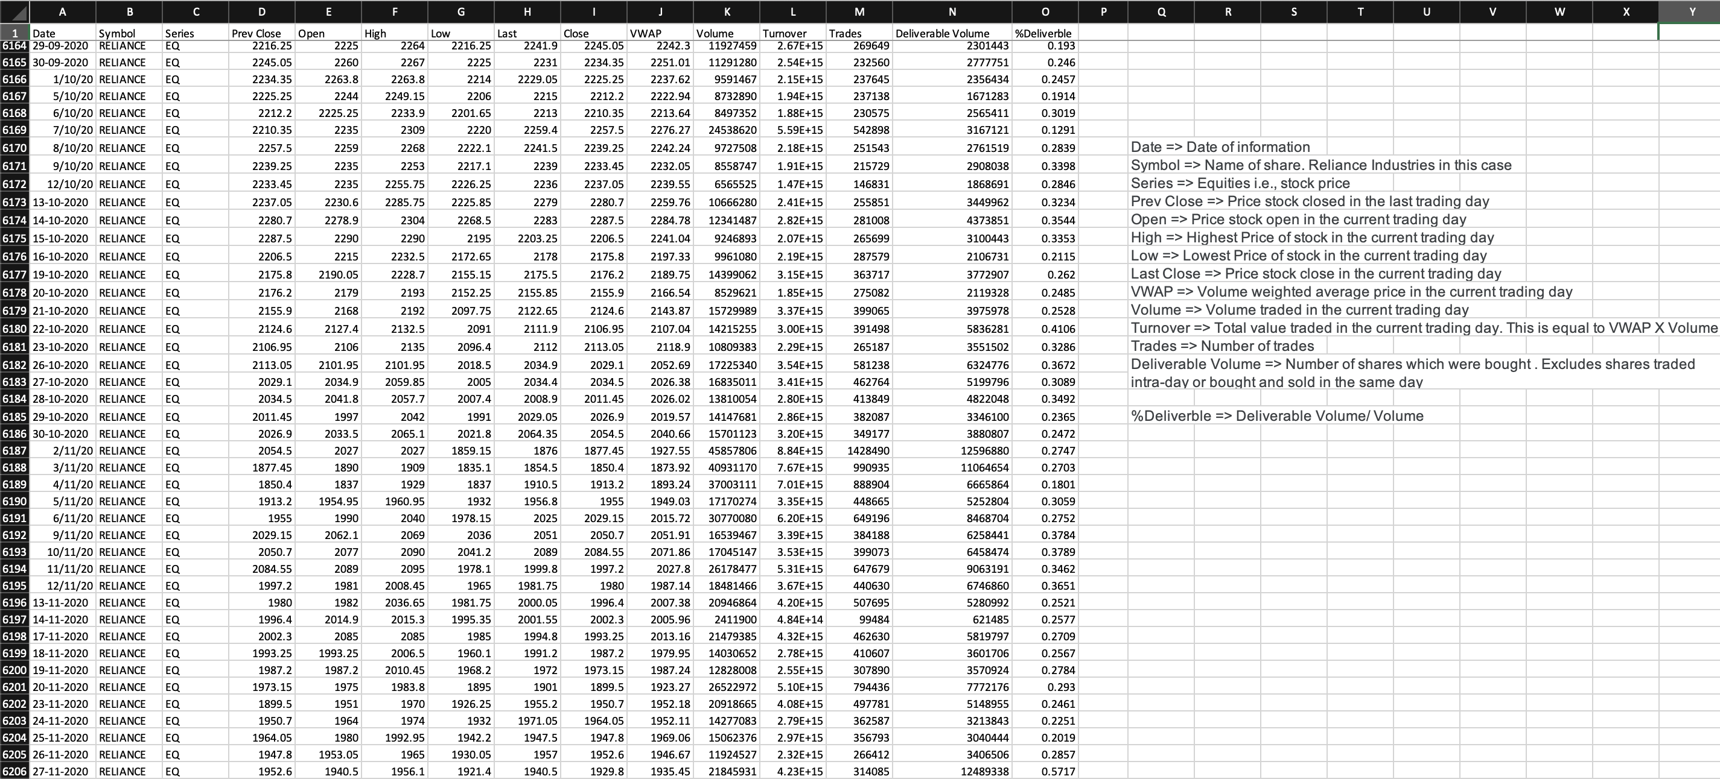
DATA OVERVIEW
For this project, we gathered data from 4 different datasets obtained from Kaggle.
The first dataset consists of 6,200 rows of data on Reliance Industries from 2011 to 2020.
The second dataset contains 1,400 data points on Reliance Industries from 2017 to 2022.
The third dataset includes crude oil prices from 2011 to 2021, with 2,200 rows of data.
The fourth dataset consists of Reliance Jio revenue data from 2017 to 2020, with 1,500 data points.
We combined all four datasets and cleaned the data to create a single dataset with 51 rows of monthly revenue data for Reliance Industries, crude oil prices, and Reliance Jio revenue from January 2017 to March 2021.

Slide 4
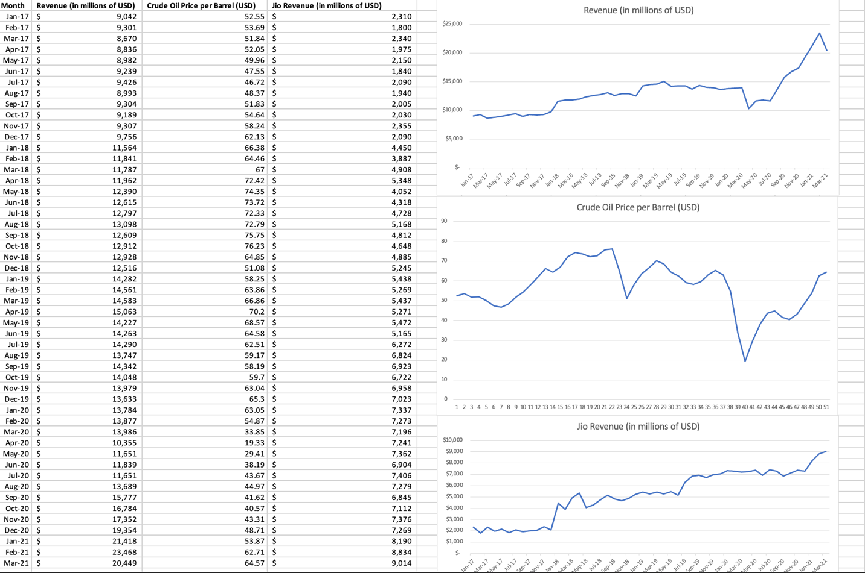
LINE CHART
Trends of Crude oil price, Reliance Jio revenue, and Reliance Industries' total revenue using an Excel line chart.
The chart indicates that both Crude oil price and Reliance Jio revenue have been increasing over time, while Reliance Industries' total revenue has been slightly declining in the last month.
It also highlights that there is a slight relationship between Reliance Industries' revenue and Crude oil price and Reliance Jio revenue.

Slide 5
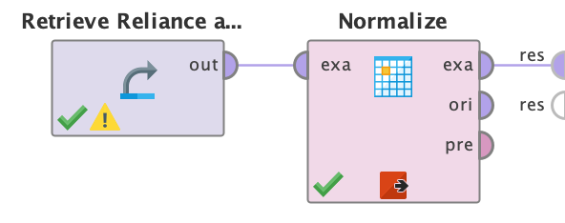
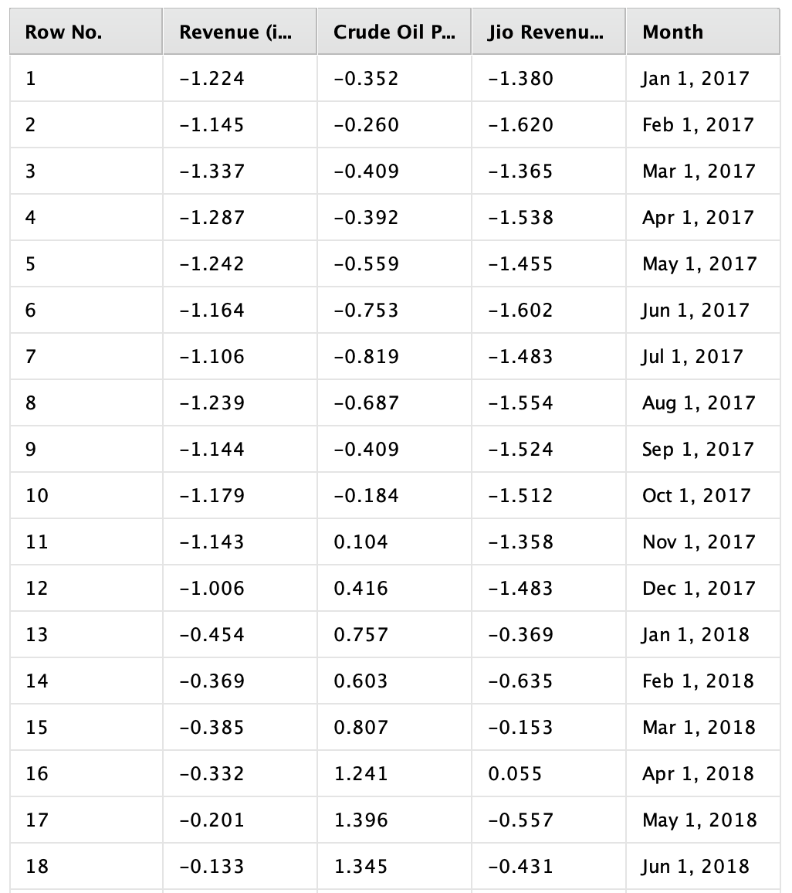
NORMALIZATION
Data normalization is important because it brings all the data to a common scale, making it easier to compare and analyze.
It eliminates the effect of the scale and units of the original data and makes the data more meaningful.
In this project, data normalization was used to ensure that all the attributes (reliance industries revenue, crude oil price, and reliance jio revenue) were on the same scale for correlation analysis.

Slide 6
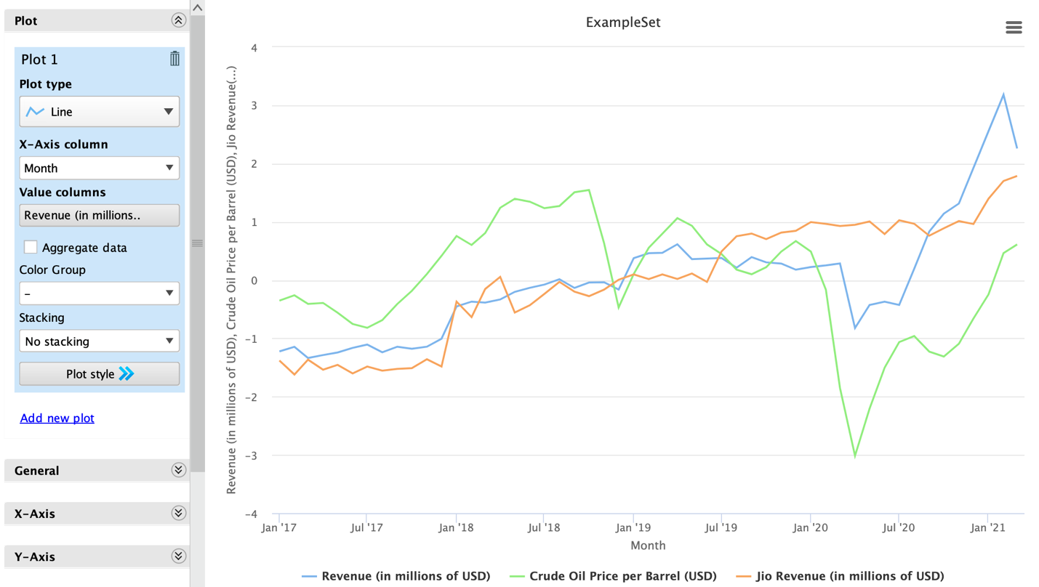
Visualization
It shows the data visualization (Plot diagram) of Reliance Industries' revenue, Reliance Jio revenue, and Crude oil price using RapidMiner Studio after normalization.
The chart helps in identifying the trends in the data and any potential relationships between the variables.

Slide 7
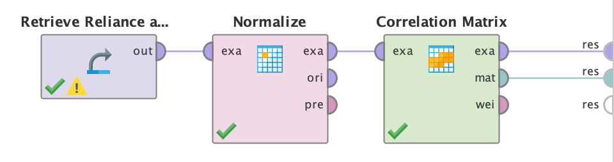
Correlation Analysis
Correlation analysis is being used in our project to assess the relationship between Reliance Industries revenue, crude oil price, and Jio revenue.
By calculating the correlation coefficient, we can determine the strength and direction of the relationship between these variables.
This analysis helps us understand the impact of crude oil price and Jio revenue on Reliance Industries' overall revenue.

Slide 8
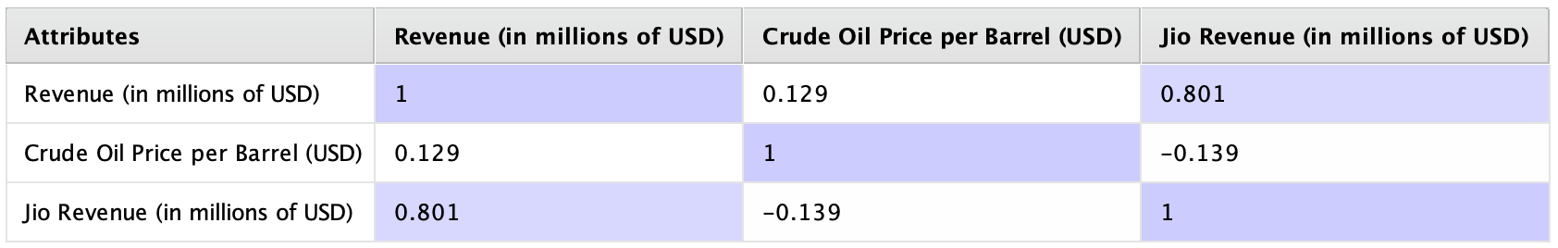
Correlation Table
The correlation coefficient between "Revenue" and "Crude Oil Price" is 0.129, indicating a weak positive correlation between the two variables.
The correlation coefficient between "Revenue" and "Jio Revenue" is 0.801, indicating a strong positive correlation between the two variables.
The correlation coefficient between "Crude Oil Price" and "Jio Revenue" is -0.139, indicating a weak negative correlation between the two variables.

Slide 9
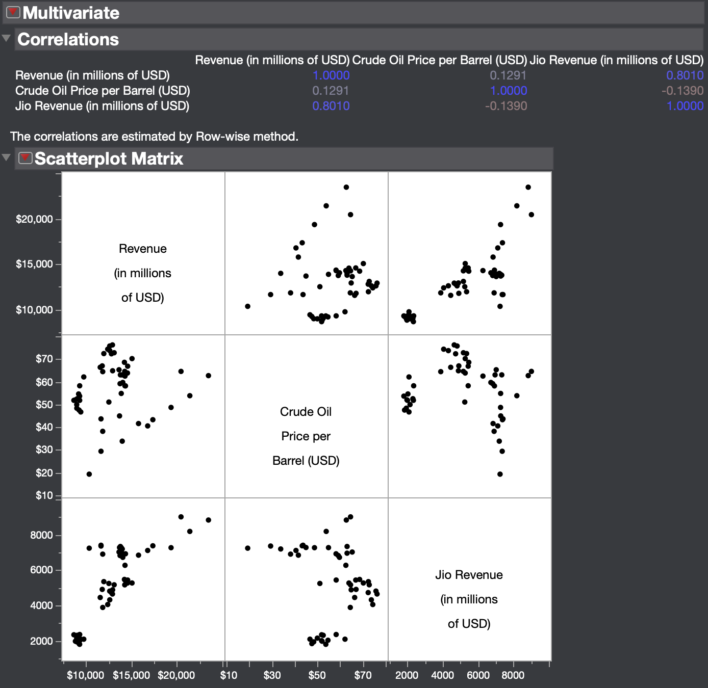
Correlation Using JMP
It explains the correlation analysis performed using JMP. It highlights that the results obtained from JMP were consistent with the results obtained using RapidMiner Studio.
It also explains the importance of correlation analysis in identifying the relationship between variables.

Slide 10

We really appreciate your patience. Thank You!

